Slide 1
Quality AI Requires Quality Data
Lower Risk, Improve Results, Avoid Embarrassment!
Edward Pollack
Microsoft Data Platform MVP

Slide 2
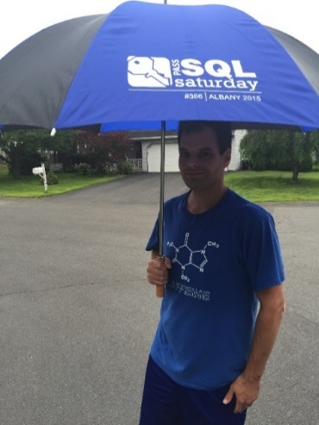






Ed Pollack
Microsoft Data Platform MVP
Published author of:
Dynamic SQL: Applications, Performance, and Security, 2nd Edition
Analytics Optimization with Columnstore Indexes in SQL Server
2nd edition forthcoming in spring 2026.
Expert Performance Indexing in SQL Server, 4th Edition
Published in Expert T-SQL Functions in SQL Server, 3rd Edition
Author on Simple Talk.
Organizes:
SQL Saturday Albany
SQL Saturday New York City
Future Data Driven
Capital Area SQL Server User Group
Speaker at many data events
Find me on: LinkedIn

Slide 3





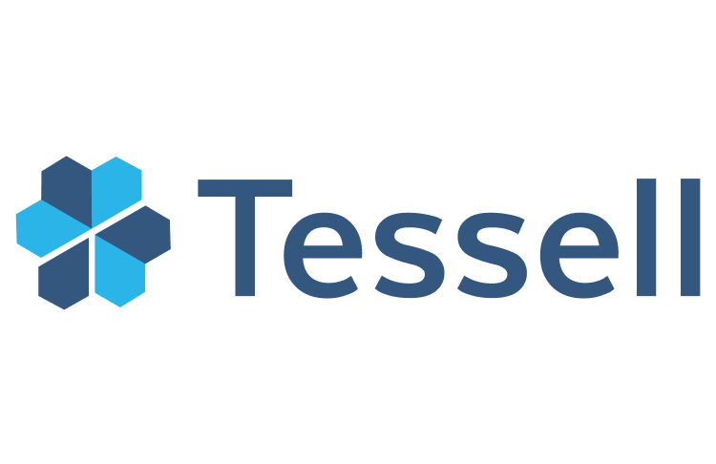






Slide 4
Agenda
How does AI use data?
Why does data quality matter?
What are frequent data mistakes made in AI?
Best practices to improve data quality.

Slide 5
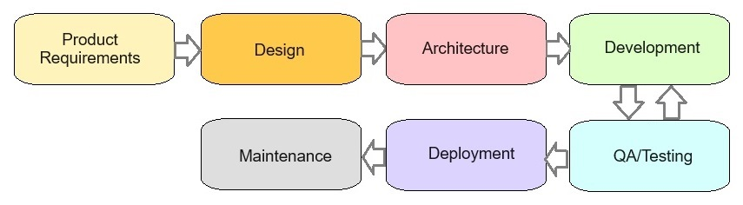
Software Development Life Cycle (Sometimes)

Slide 6
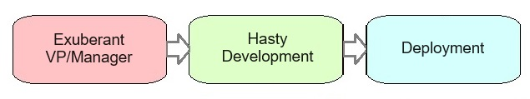
AI Development Life Cycle (Sometimes)

Slide 7
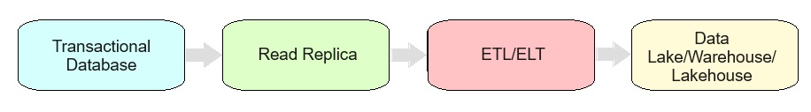
Challenges of Data & AI
Data grows and evolves over time
Data may be copied/moved/transformed many times prior to ML/AI
Existing data quality is inherited by downstream processes
AI processes are often quite authoritative

Slide 8
An Important Reminder!
AI Algorithms are software tools.
They are trained on, and act on data.
Your software/apps are what use AI and bring meaning to those underlying algorithms.
Therefore, YOU are responsible for how AI apps consume, process, output, and create data.

Slide 9
How can we
prevent bad data?

Slide 10

OLTP/App/Edge Data: Data Starts Here!
This is bad application data!
Its data journey begins here.
Bad data from here will persist forever.

Slide 11
Validate OLTP/App/Edge Data
Application constraints/restrictions
Routine data validation processes
Unique indexes/constraints
Foreign keys
Check constraints
Many of the above!

Slide 12
Validate ETL/ELT Data
Validate data during movement
Before vs. after testing
Metrics (Counts, min, max, sum, etc…)
Value-based validation
Are values realistic/correct?

Slide 13
Validate OLAP/Report/Analytic Data
Validate data after movement:
Data size (row count, byte count, etc…)
Validate values (uniqueness, NULL? invalid values?)
Missing data?
Duplicate data?
Edge-cases?
Inconsistent values?
Validate BEFORE training models/RAG!

Slide 14

Post-Release Validation
When code changes, validate impacted data
Back up any data-to-be-modified!
Without QA, existing data/validation may become incomplete/incorrect.

Slide 15
New Columns & Changed Meaning
New types/values added to existing data set.
Note the time-boundary and its significance!
How to handle new data points prior to release?
What to do when data meaning/definition changes.
Note when metrics are valid from/to

Slide 16
Names/Data Types Matter!
Poorly named data elements can trick AI (or us!) into making bad decisions.
Poorly typed data can confuse AI.
Is data excluded due to metadata values?
Check with original data source, if needed.
Integer named “Invoice”? What is it?
Datetime named “EntryTime”? Is it date/time or time?
Column named “IsDeleted”: Should AI use this data?

Slide 17
Note: Training Data vs. RAG Data
Both are important for a scalable AI application
Both can experience bad data
Bad training data = misbehaving model
Bad RAG data = incorrect responses

Slide 18
Data Documentation
Maintain documentation on critical data
Data Dictionary?
Sharable between teams/departments
Document processes that copy/move/transform data.

Slide 19
How do we cheat bad data?

Slide 20
Prompt Engineering
Improves AI interactions and output
Delineates purpose
Ensures relevance
Refines inputs/outputs
Cannot prompt your way out of bad data!

Slide 21
RAG (Retrieval Augmented Generation)
This is “your” data that is used to provide meaningful output
Train model on one data set, use another data set for RAG.
Cannot be used to “fix” bad training
Fixing/updating bad RAG data is not hard.

Slide 22
Semantic Search
Breaks data into chunks, creating mathematical associations of similarity.
Bad data will create bad associations that are hard to find and fix.
Vectorization detail can be used, if needed, to reverse engineer bad results (this isn’t fun!)

Slide 23
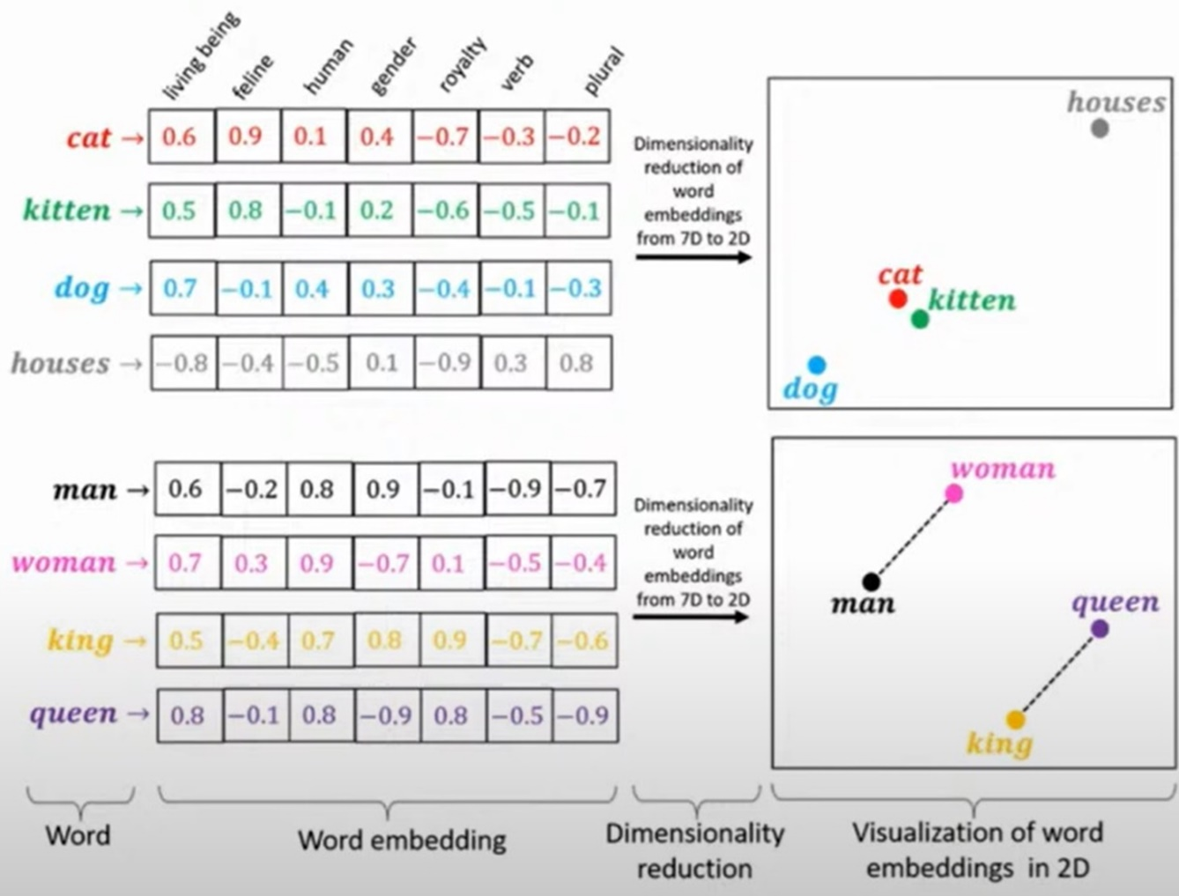
Semantic Search

Slide 24

Fine-Tuning
Allows a model to be tailored to a more specific use-case.
Adds specific domain-knowledge to data.
Requires non-trivial time/effort to implement.
Is NOT a solution to bad data.

Slide 25
More Data is Not Always Better!
Ensure data points are:
Accurate
Relevant
Complete
Reduce Noise
Remove data that will lead to bad training or bad responses.

Slide 26
Synthetic Data
Artificially-generated data
Mimics real-world data
Same mathematical properties
Different information
Can remove PII/protected data
Hard to generate without bias/replication/bad data
Need to prove that new data is valid AND unique.
Cannot dilute bad data with good synthetic data
Must be validated.

Slide 27
Unlearning Data Can Harm Models
Unlearning involves forcing a model to forget specific information.
PII
Bad data
Copyrighted material
Beware legal/compliance issues
Removing data elements completely is hard to prove
Test carefully to ensure no adverse side-effects
Consider updating training data & retraining a model

Slide 28
Feedback Loops
AI can create/modify insights, data, responses, and content
Beware this new data becoming part of existing data
Is this intentional!?
Feedback loops can amplify some results or diminish others.
Separating new data from previous data can be a useful way to ensure that problems are isolated.
Use caution when adding new data to existing data sets!

Slide 29

Conclusion
Bad data is most easily resolved at its source.
Data quality rules have not changed over the years!
AI model manipulation is not a substitute for good data.
Carefully test models and ensure that invalid responses are identified and resolved by finding their origin.

Slide 30
Questions? Thank You!
Find me here:
Ed Pollack | LinkedIn
Edward Pollack | Most Valuable Professionals
https://sessionize.com/edward-pollack/
Find my content here:
EdwardPollack (Ed Pollack) (github.com)
Edward Pollack, Author at Simple Talk (red-gate.com)
Ed Pollack, Author at SQL Shack - articles about database auditing, server performance, data recovery, and more

Slide 31


Session Evaluation Win 6x$50 gift card
Event Evaluation Win $100 gift card

